Slide 1
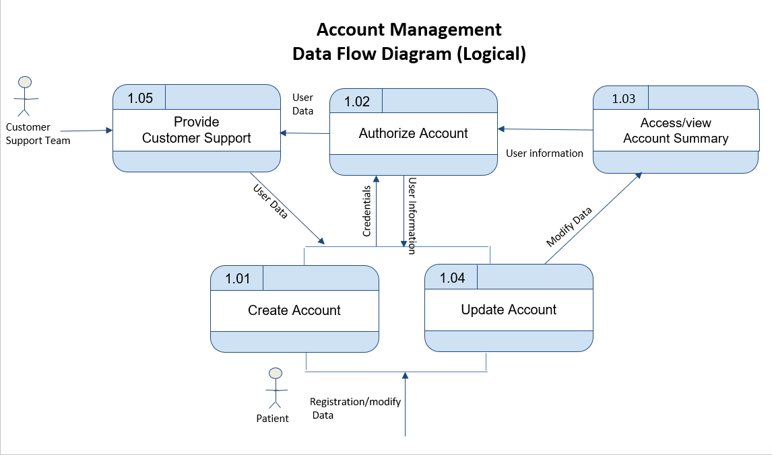

Slide 2

​Data Flow Diagram (Logical) – Patient Dashboard
02.02 Update personal Information
Credentials
02.01 Sign up an Account
02.03 Browse Doctor Profiles
02.04 Check Doctors Availability
02.05 Book Appointment
Registration request
Login data
Doctors Data
Booking Request
User

Slide 3
​Data Flow Diagram (Physical) – Patient Dashboard
02.02 Update personal Information
Update Patient Data
Update Patient Data
Credentials
D1 Patient
D2 Account Management
D6 Appointment
D3 Specialties
D4 Doctors
D5 Schedule
New Account Data
Doctors Data
List Schedule Data
New Patient Data
Update Appointment data
02.01 Sign up an Account
02.03 Browse Doctor Profiles
02.04 Check Doctors Availability
02.05 Book Appointment
Registration request
Login data
Doctors Data
Booking Request
User

Slide 4
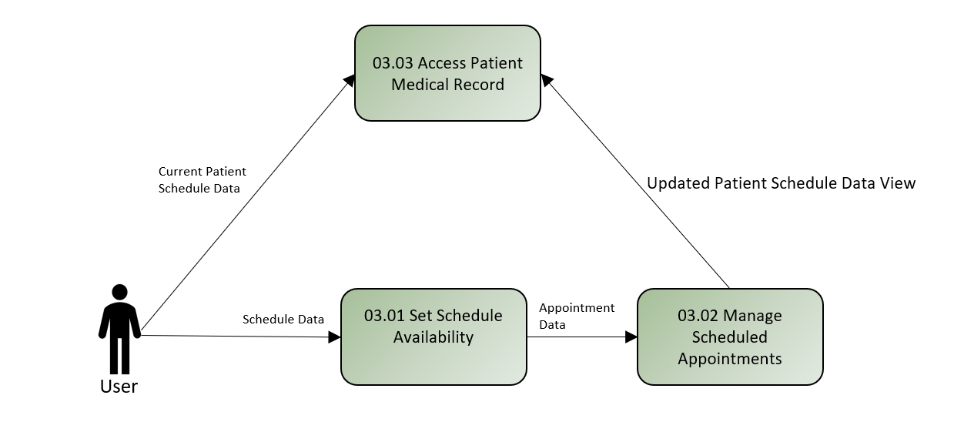
Data Flow Diagram (Logical) – Patient Dashboard
​

Slide 5
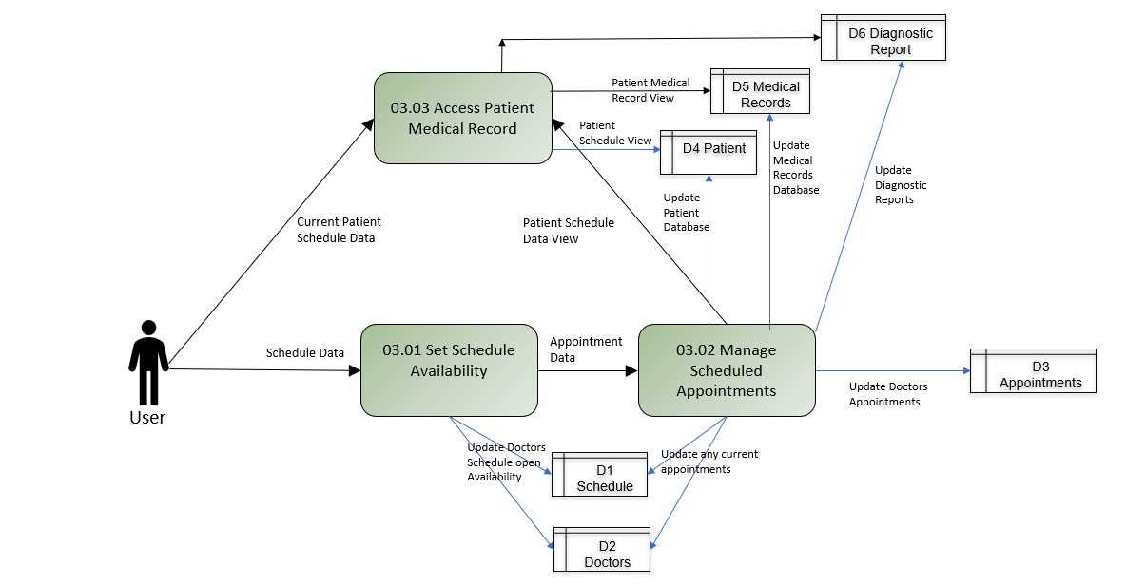
Data Flow Diagram (Physical) – Patient Dashboard

